Slide 1
STGEC 2016: Slope Analysis w/
Finite Element Method
S.Johnson@plaxis.com
Plaxis Americas
Notes:
Initial stresses and phi/c reduction
CG1 Querétaro, México - 2011

Slide 2

Introduction
Numerical Methods are increasing being used to model Geotechnical Problems, such as slopes, foundations, consolidation behavior, seepage, dynamics, etc.
It is important to gain some familiarity how a numerical model works, in contrast to exact methods
Thus even if you do not use a numerical model in Geotech analysis, it is likely you will encounter reports by consultants using numerical analysis.
    So you should have knowledge of basic FEM concepts

Slide 3
Concepts of soil modelling
Relationship between stresses (stress rates) and strains (strain rates)
Elasticity (reversible deformations) dσ=f (dε)
  Example: Hooke’s law
Plasticity (irreversible deformations) dσ=f (dε,σ,h)
  Perfect plasticity, strain hardening, strain softening
  Yielding, yield function, plastic potential, hardening/softening rule
  Example: Mohr-Coulomb yielding
Time dependent behaviour (time dependent deformations)
  Biot’s (coupled) consolidation dσ=f (dε,σ,t)
  Creep, stress relaxation
  Visco elasticity, visco plasticity
$s_{\text{yy}}$
$s_{\text{yx}}$
$s_{\text{yz}}$
$s_{\text{xy}}$
$s_{\text{zy}}$
$s_{\text{zx}}$
$s_{\text{xz}}$
$s_{\text{xx}}$
$s_{\text{zz}}$
Notes:
CG02 - Mohr-Coulomb model
CG1 - Brisbane, Australia - Sept/Oct 2014

Slide 4
Program structure
FEM Input
  Definition of the problem (physical representation)
  Definition of the building process:
    Initial situation
    Construction stages
FEM Output
  View results of
    the entire model at a specific moment during construction
    one specific point during the whole construction process (history)
Notes:
CG04 - Introduction to Plaxis 2D
CG1 Madrid, Spain - June 2015

Slide 5
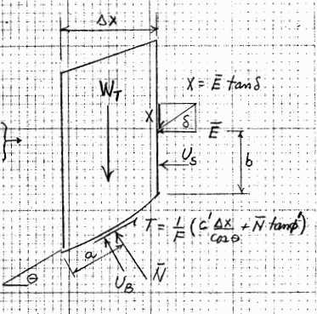
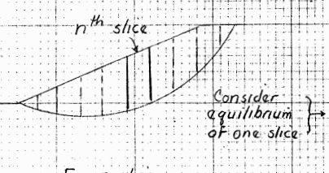
Analytical Methods
Calculations are broken down into slices where force & moment equations are solved assuming static equilibrium:
  Bishop, Janbu, Spencer, etc.

Slide 6
Assumptions
Assume Failure Mechanism
Assume simplified soil layering
Assume a Mohr-Coulomb framework with a linear-elastic perfectly plastic material behavior
Limit Equilibrium about some assumed point of rotation
Indeterminacy (more unknowns than equations), [solved by assuming the reaction force N of a slice is normal to the failure surface]

Slide 7
So why FEM?
Assesses near infinite number of failure mechanisms in 2D or 3D.
Allows for Structural Elements (Piles, Wells, Tiebacks, Soil Nails, Etc.)
Allows for the design of geotechnical scenarios and phased construction
Allows for Advanced Constitutive models, non-linear stiffness soil behavior
Determines the stress field, at failure and before based on sound numerical theories that are calibrated and validated extensively.
Additionally: Undrained/Partially Drained, Flow, Dynamics, Thermal, etc.

Slide 8
Safety Analysis in PLAXIS
Strength reduction method: Phi/c reduction
Same numerical tool as for serviceability design
Automatically detects most critical failure mechanism

Slide 9
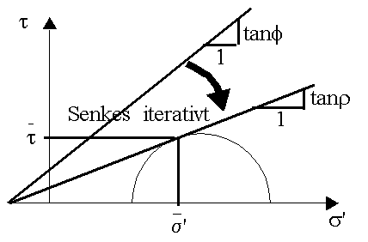
Safety Analysis
Phi/c reduction:
  Reduction of strength parameters until failure is reached.
Using effective strength :
Using undrained shear strength :
ΣMsf = strength reduction factor

Slide 10
Safety Analysis in PLAXIS
Notes on the Safety calculation:
During a Safety calculation all advanced soil models reduce to
  Linear Elastic-Perfectly Plastic with stiffness based on the starting stress state.
  Safety calculation also reduces Tension cut-off stress
  Residual strength for interfaces and structural elements is not taken into account
  Soil models for which strength is not based on φ and c (for instance the Hoek-Brown model) an equivalent method is used to reduce strength in a Safety calculation

Slide 11
Safety Analysis in PLAXIS - Calculation
Strength reduction with a predefined factor (Target Σ-Msf)
  Create a Safety phase:
    Set Loading input to Target Σ-Msf
    Specify a target reduction factor
  Calculate
Note: Plaxis will calculate until failure occurs to check Target Σ-Msf < FoS
Target Σ-Msf
FoS
Σ-Msf
Σ-Msf
FoS
Target Σ-Msf
u
u
Target Σ-Msf < FoS: OK
Target Σ-Msf > FoS : Error

Slide 12
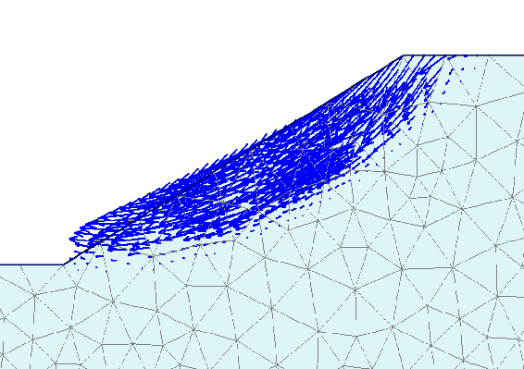
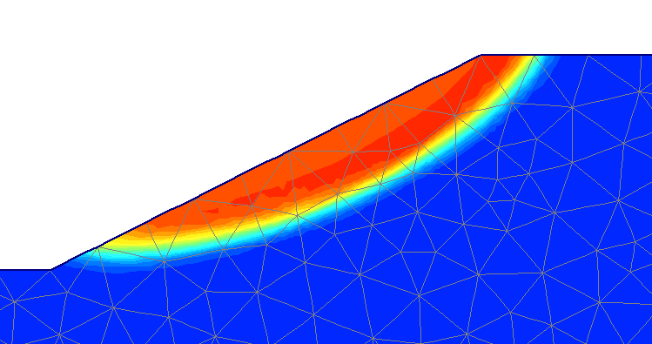
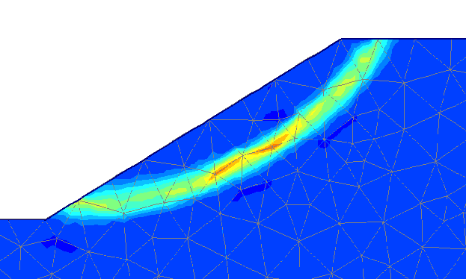
Use different plots to check failure mechanism
Factor of Safety in PLAXIS
Incremental displacements
(arrows)
Incremental displacements
(shadings)
Incremental shear strains
(shadings)

Slide 13
Structural Interaction
Influence of material behaviour of walls, anchors and geotextiles
  Elastic
    Factor of safety based on soil strength only
  Elasto-plastic
    Early structural failure may promote soil failure: lower factor of safety
    Strength of walls, anchors and geotextiles is not reduced
Elastic
wall
Elasto-plastic
wall

Slide 14
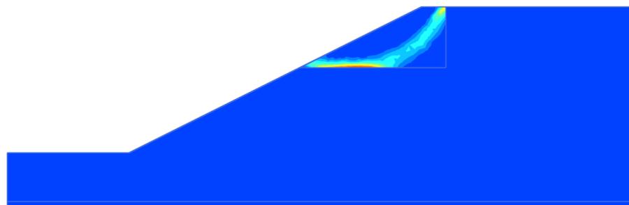
Factor of Safety in PLAXIS
Automatic detection of most critical shear surface
  Local failure surface that is unimportant from engineering point of view:
Local failure
Possible solutions
Locally apply an increased soil strength just in Safety analysis
Locally apply a stabilizing load just in Safety analysis
Note: Changes should be as small as possible to prevent interfering with other possible (global) failure mechanisms.

Slide 15
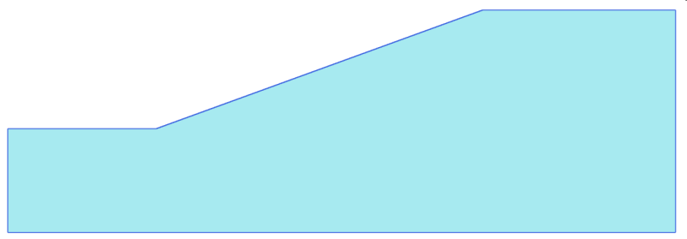
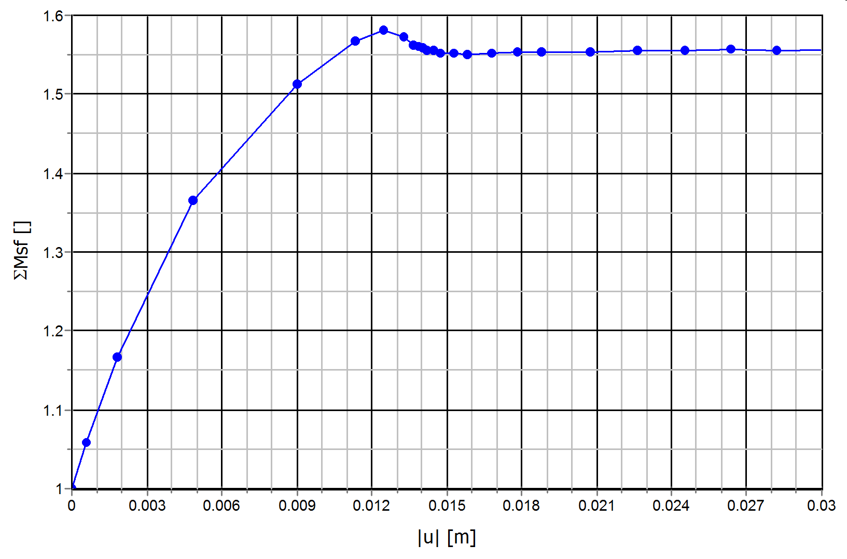
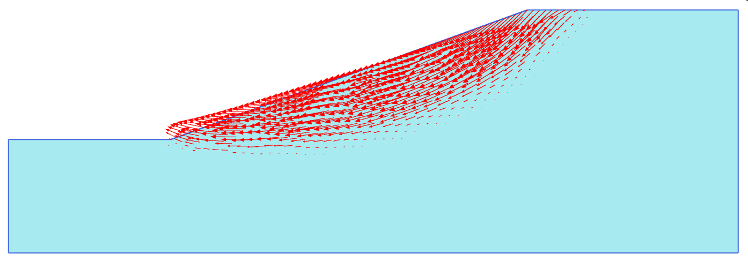
Example 1 – Stability of a Drained Slope
ΣMsf=1.56
= 16 kN/m³
= 20º
c=5 kPa

Slide 16
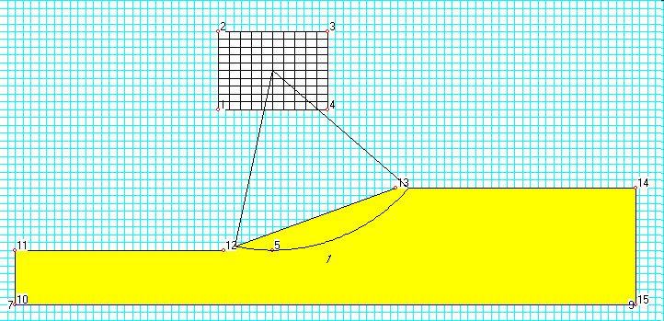
Example 1 – Stability of a Drained Slope
Bishop analysis:
Bishop analysis: FoS = 1.60
PLAXIS analysis: FoS = 1.56

Slide 17
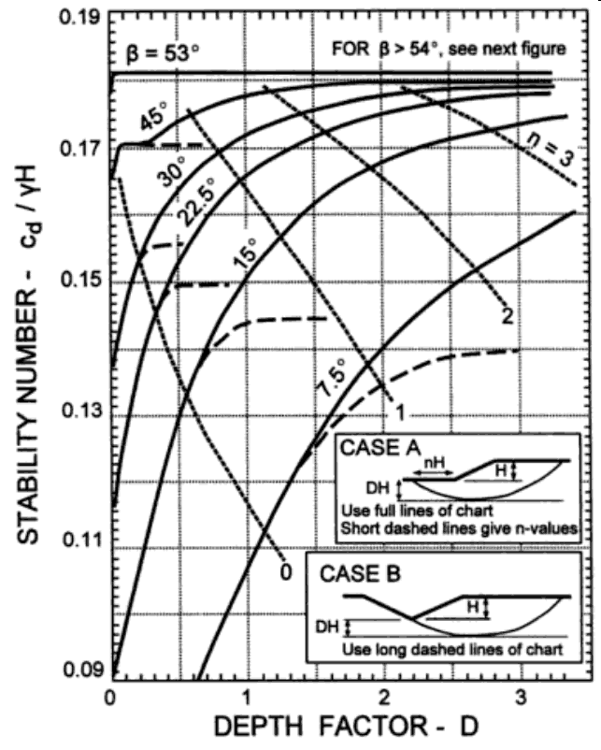
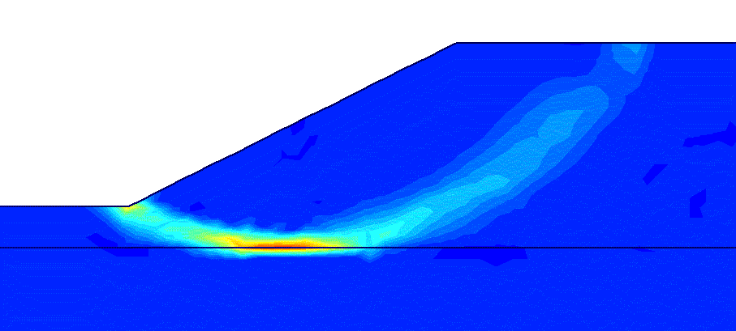
Example 2 – Stability of an Undrained Slope
Taylor charts:
γ_{soil} = 20 kN/m³
β
2
L
H
1
c_{u} = 50 kPa
c_{u} = 100 kPa
N₀
H = 12m
L = 16m
→ Depth factor, D = (L-H)/H = 0.33
tan(β) = 1/2 → β = 26.6°
PLAXIS analysis: F = 1.36
0.33
(Taylor,1948)

Slide 18
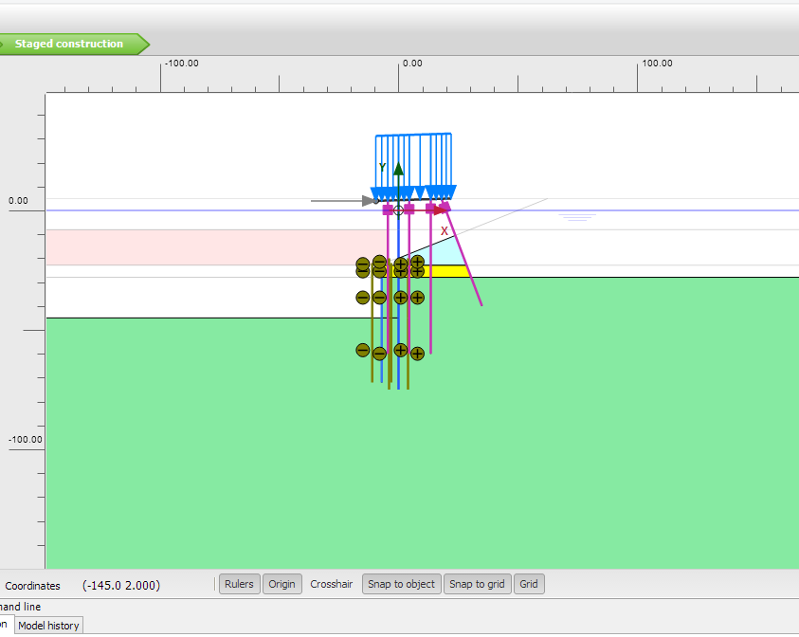

Slide 19
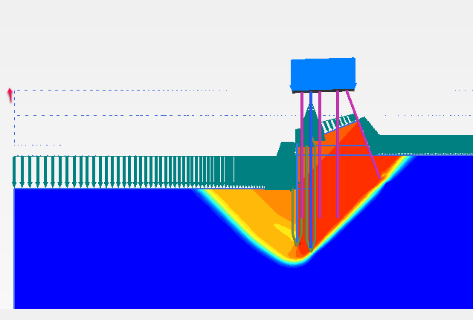

Slide 20
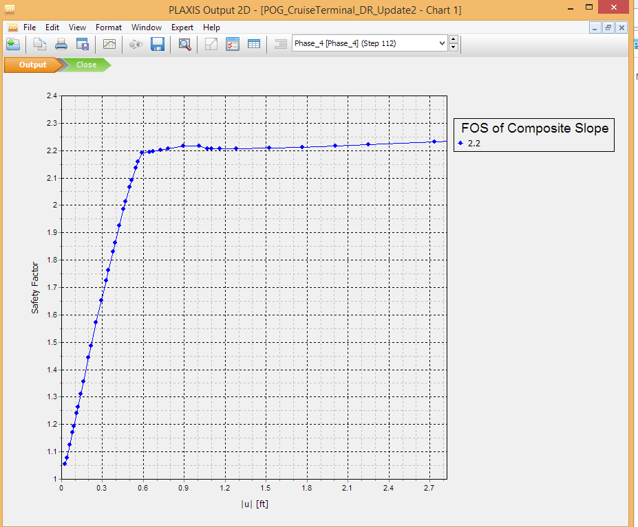
Analytical analysis: FoS = Not Possible!
PLAXIS analysis: FoS = 2.2

Slide 21
Summary & Recommendations
Finite Element Method determines a safety factor on soil strength.
A Safety calculation will find the most critical failure mechanism.
The strength reduction method (phi/c reduction) used in a Safety calculation gives a factor of safety comparable to other methods (e.g. Bishop method)
FEM allows for complicated geometry that are possible using exact methods
FEM captures soil structure interaction
It is a good idea to have some background in numerical methods as computer modeling becomes more popular for geotechnical engineers.

Slide 22
References
Brinkgreve, R.B.J., Bakker, H.L. (1991)
Non-linear finite element analysis of safety factors.
In Proc. 7th Int. Conf. On Comp. Methods and Advances in Geomechanics, Cairns, Australia, 1117-1121
Benz, T., Schwab, R., Vermeer, P.A., Kauter, R.A. (2007)
A Hoek-Brown criterion with intrinsic material strength factorization.
Int. Journal of Rock Mechanics and Mining Sci., 45(2), 210-222

